Slide 1
Visualizing Amounts
HUGEN 2073
Genomic Data Visualization and Integration
Slides borrowed/adapted from H.J. Park with permission

Slide 2
Today we’ll discuss
Tables
Barplots
Grouped
Stacked
Dotplots
Line graphs
Bubble charts

Slide 3
A table shows detailed information for a limited number of samples
Describe experiment or clinical data, thus important for data-oriented papers (clinical journals)
Row and column are usually not interchangeable
Row: an observation (e.g., a sample)
Column: feature of the data
Highest-grossing films
Rank | Title | Gross income | Year
1 | Avengers: Endgame | $2,797,800,564 | 2019
2 | Avatar | $2,789,679,794 | 2009
3 | Titanic | $2,187,463,944 | 1997
4 | Star Wars: The Force Awakens | $2,068,223,624 | 2015
5 | Avengers: Infinity War | $2,048,359,754 | 2018
6 | Jurassic World | $1,671,713,208 | 2015
7 | The Lion King film currently playing | $1,654,637,574 | 2019
8 | The Avengers | $1,518,812,988 | 2012
9 | Furious 7 | $1,516,045,911 | 2015
10 | Avengers: Age of Ultron | $1,405,403,694 | 2015
https://en.wikipedia.org/wiki/List_of_highest-grossing_films
Notes:
Bad tables are quite common (more than bad figures?)
Lots of default settings in table-making software aren’t good

Slide 4
Tables can show exact values
Highest-grossing films
Rank | Title | Gross income | Year
1 | Avengers: Endgame | $2,797,800,564 | 2019
2 | Avatar | $2,789,679,794 | 2009
3 | Titanic | $2,187,463,944 | 1997
4 | Star Wars: The Force Awakens | $2,068,223,624 | 2015
5 | Avengers: Infinity War | $2,048,359,754 | 2018
6 | Jurassic World | $1,671,713,208 | 2015
7 | The Lion King film | $1,654,637,574 | 2019
8 | The Avengers | $1,518,812,988 | 2012
9 | Furious 7 | $1,516,045,911 | 2015
10 | Avengers: Age of Ultron | $1,405,403,694 | 2015
(There is a way a barchart could show exact values, but a table does so more naturally.)
Notes:
For example, you might be interested in the exact earning of either some or all of these movies.
If you draw a figure to see the information, it is not easy.

Slide 5
Tables can show multiple variables
E.g., if we’re interested in ranking, gross income, and year
An effective way to avoid 3D plotting
Highest-grossing films
Rank | Title | Gross income | Year
1 | Avengers: Endgame | $2,797,800,564 | 2019
2 | Avatar | $2,789,679,794 | 2009
3 | Titanic | $2,187,463,944 | 1997
4 | Star Wars: The Force Awakens | $2,068,223,624 | 2015
5 | Avengers: Infinity War | $2,048,359,754 | 2018
6 | Jurassic World | $1,671,713,208 | 2015
7 | The Lion King film currently playing | $1,654,637,574 | 2019
8 | The Avengers | $1,518,812,988 | 2012
9 | Furious 7 | $1,516,045,911 | 2015
10 | Avengers: Age of Ultron | $1,405,403,694 | 2015
Notes:
Also, when we have to more than two measures to show, we might prefer tables to figures.
There are ways to give three measures to figures, but involves going to 3D.
However, figures are much more difficult to read when they are in 3D.

Slide 6
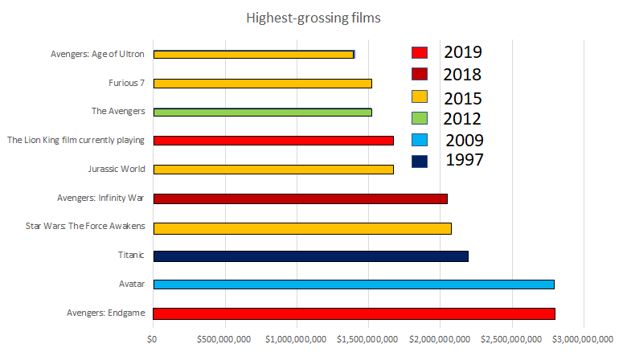
Tables when you have many categories
E.g., grouping by year
The table can’t do this quite as well as the barplot
Too many labels/categories in the legend?
Good for exploratory work on a small amount of data?
Highest-grossing films
Rank | Title | Gross income | Year
1 | Avengers: Endgame | $2,797,800,564 | 2019
2 | Avatar | $2,789,679,794 | 2009
3 | Titanic | $2,187,463,944 | 1997
4 | Star Wars: The Force Awakens | $2,068,223,624 | 2015
5 | Avengers: Infinity War | $2,048,359,754 | 2018
6 | Jurassic World | $1,671,713,208 | 2015
7 | The Lion King film currently playing | $1,654,637,574 | 2019
8 | The Avengers | $1,518,812,988 | 2012
9 | Furious 7 | $1,516,045,911 | 2015
10 | Avengers: Age of Ultron | $1,405,403,694 | 2015
Notes:
Also, let’s say you are interested in the production year of the movies.
You can draw figures with the production year information.
But then there are probably too many categories in the figure.

Slide 7
What is a good table for presentation?
In terms of maximizing data-ink ratio…
Rank | Title | Gross income($) | Year
1 | Avengers: Endgame | 2,797,800,564 | 2019
2 | Avatar | 2,789,679,794 | 2009
3 | Titanic | 2,187,463,944 | 1997
4 | Star Wars: The Force Awakens | 2,068,223,624 | 2015
5 | Avengers: Infinity War | 2,048,359,754 | 2018
Rank | Title | Gross income($) | Year
1 | Avengers: Endgame | 2,797,800,564 | 2019
2 | Avatar | 2,789,679,794 | 2009
3 | Titanic | 2,187,463,944 | 1997
4 | Star Wars: The Force Awakens | 2,068,223,624 | 2015
5 | Avengers: Infinity War | 2,048,359,754 | 2018
Rank | Title | Gross income($) | Year
1 | Avengers: Endgame | 2,797,800,564 | 2019
2 | Avatar | 2,789,679,794 | 2009
3 | Titanic | 2,187,463,944 | 1997
4 | Star Wars: The Force Awakens | 2,068,223,624 | 2015
5 | Avengers: Infinity War | 2,048,359,754 | 2018
Rank | Title | Gross income($) | Year
1 | Avengers: Endgame | 2,797,800,564 | 2019
2 | Avatar | 2,789,679,794 | 2009
3 | Titanic | 2,187,463,944 | 1997
4 | Star Wars: The Force Awakens | 2,068,223,624 | 2015
5 | Avengers: Infinity War | 2,048,359,754 | 2018
Notes:
The first table has both vertical and horizontal lines for all the cells while the second one has borderline only between the header and the content.
Remove color
Remove vertical bars
Remove enclosing vertical bars at left/right

Slide 8
What is a good table for presentation?
In terms of maximizing data-ink ratio…
Rank | Title | Gross income($) | Year
1 | Avengers: Endgame | 2,797,800,564 | 2019
2 | Avatar | 2,789,679,794 | 2009
3 | Titanic | 2,187,463,944 | 1997
4 | Star Wars: The Force Awakens | 2,068,223,624 | 2015
5 | Avengers: Infinity War | 2,048,359,754 | 2018
Rank | Title | Gross income($) | Year
1 | Avengers: Endgame | 2,797,800,564 | 2019
2 | Avatar | 2,789,679,794 | 2009
3 | Titanic | 2,187,463,944 | 1997
4 | Star Wars: The Force Awakens | 2,068,223,624 | 2015
5 | Avengers: Infinity War | 2,048,359,754 | 2018
Rank | Title | Gross income ($) | Year
1 | Avengers: Endgame | 2,797,800,564 | 2019
2 | Avatar | 2,789,679,794 | 2009
3 | Titanic | 2,187,463,944 | 1997
4 | Star Wars: The Force Awakens | 2,068,223,624 | 2015
5 | Avengers: Infinity War | 2,048,359,754 | 2018
Rank | Title | Gross income ($) | Year
1 | Avengers: Endgame | 2,797,800,564 | 2019
2 | Avatar | 2,789,679,794 | 2009
3 | Titanic | 2,187,463,944 | 1997
4 | Star Wars: The Force Awakens | 2,068,223,624 | 2015
5 | Avengers: Infinity War | 2,048,359,754 | 2018
Notes:
(2nd table here is first from previous slide)
Remove bottom line
Remove other unnecessary lines
Only remaining line is the one separating header from data.

Slide 9
What is a good table for presentation?
In terms of alignment of text/number/single character columns…
Rank | Title | Gross income | Year
1 | Avengers: Endgame | 2,797,800,564 | 2019
2 | Avatar | 2,789,679,794 | 2009
3 | Titanic | 2,187,463,944 | 1997
4 | Star Wars: The Force Awakens | 2,068,223,624 | 2015
5 | Avengers: Infinity War | 2,048,359,754 | 2018
Rank | Title | Gross income | Year
1 | Avengers: Endgame | 2,797,800,564 | 2019
2 | Avatar | 2,789,679,794 | 2009
3 | Titanic | 2,187,463,944 | 1997
4 | Star Wars: The Force Awakens | 2,068,223,624 | 2015
5 | Avengers: Infinity War | 2,048,359,754 | 2018
Rank | Title | Gross income ($) | Year
1 | Avengers: Endgame | 2,797,800,564 | 2019
2 | Avatar | 2,789,679,794 | 2009
3 | Titanic | 2,187,463,944 | 1997
4 | Star Wars: The Force Awakens | 2,068,223,624 | 2015
5 | Avengers: Infinity War | 2,048,359,754 | 2018
Rank | Title | Gross income ($) | Year
1 | Avengers: Endgame | 2,797,800,564 | 2019
2 | Avatar | 2,789,679,794 | 2009
3 | Titanic | 2,187,463,944 | 1997
4 | Star Wars: The Force Awakens | 2,068,223,624 | 2015
5 | Avengers: Infinity War | 2,048,359,754 | 2018
Notes:
What’s good/bad about these?
OK
Centered text – bad. Also the numbers are squashed together.
Spaced better, includes units. Still the centered text isn’t good.

Slide 10
What is a good table for presentation?
In terms of decimal places… generally use only 1 or 2
Notes:
Source: https://i0.wp.com/newmr.org/wp-content/uploads/sites/2/2018/08/Pic-1.png?ssl=1

Slide 11
Rule of thumb for good table presentation
Rank | Title | Worldwide gross | Year
1 | Avengers: Endgame | $2,797,800,564 | 2019
2 | Avatar | $2,789,679,794 | 2009
3 | Titanic | $2,187,463,944 | 1997
4 | Star Wars: The Force Awakens | $2,068,223,624 | 2015
5 | Avengers: Infinity War | $2,048,359,754 | 2018
A horizontal line between the header and the first data row only
Text columns should be left aligned
Number columns should be right aligned and should use the same number of decimal digits throughout. (Columns containing single characters are centered.)
Notes:
Why each rule?
“When authors draw tables with horizontal lines between data rows, the intent is usually to help the eye follow individual lines. However, unless the table is very wide and sparse, this visual aid is not normally needed. We don’t draw horizontal lines between rows in a piece of regular text either. The cost of horizontal (or vertical) lines is visual clutter. Compare parts (a) and (c) of Figure 22.7. Part (c) is much easier to read than part (a). If we feel that a visual aid separating table rows is necessary, then alternating lighter and darker shading of rows tends to work well without creating much clutter (Figure 22.7d).” – Chapter 22 of our textbook.

Slide 12
Rule of thumb for good table presentation
Rank | Title | Worldwide gross ($) | Year
1 | Avengers: Endgame | 2,797,800,564 | 2019
2 | Avatar | 2,789,679,794 | 2009
3 | Titanic | 2,187,463,944 | 1997
4 | Star Wars: The Force Awakens | 2,068,223,624 | 2015
5 | Avengers: Infinity War | 2,048,359,754 | 2018
4. The header fields are aligned with their data
5. Unit should be notated in header
6. For big numbers, use commas (1,000 separator)

Slide 13
Barplot to replace table with a particular focus
Let’s say we are interested in the gross income
Rank | Title | gross income ($) | Year
1 | Avengers: Endgame | 2,797,800,564 | 2019
2 | Avatar | 2,789,679,794 | 2009
3 | Titanic | 2,187,463,944 | 1997
4 | Star Wars: The Force Awakens | 2,068,223,624 | 2015
5 | Avengers: Infinity War | 2,048,359,754 | 2018
6 | Jurassic World | 1,671,713,208 | 2015
7 | The Lion King film currently playing | 1,654,637,574 | 2019
8 | The Avengers | 1,518,812,988 | 2012
9 | Furious 7 | 1,516,045,911 | 2015
10 | Avengers: Age of Ultron | 1,405,403,694 | 2015
?
Notes:
As I told you, if we are interested in multiple units of measure, a table is likely better.
However, in practice, we often need to determine a variable to focus on.
Let’s say we want to do that for this table.
Then, we can draw a figure where bar height represents the worldwide gross.
In the figure, movie title should be placed under each bar.
However, they are often so long that they won’t fit.
I made further modifications.
What did I do?

Slide 14
Long labels?
Maximizing not only data-ink ratio and readability, but also information amount per space
Notes:
One way is to broaden the bars/space between bars and make the title small enough to fit.
This might be a waste of space, though.
First, what kind of information is delivered?
It is bar heights in reference to y-axis values, along with movie title.
In other words, bar widths and spaces between bars take up the space without conveying information.

Slide 15
Multi-line labels?
Size of the previous figure
Notes:
Since bar widths and spaces between bars take up space without adding info, we can write the titles in multiple lines to reduce the wasted space and fit better.
However, I still think this figure wastes space…

Slide 16
Tilted labels?
Size of the previous figure
Notes:
Sometimes when you want to keep x-axis labels as-is or you need to make the figure thinner, you might want to tilt the movie titles.
I personally think this figure delivers the message more efficiently without wasting as much space.
(But this might be ugly or hard to read.)

Slide 17
Efficient figures make information readily accessible
The same amount of information in
Bar height and width
Font size
?
Maximizing data-ink ratio, readability, and information amount
Notes:
If we consider efficiency to be the amount of information relative to the space used for figure…
To me, the total amount of information in each the two versions is same, but the used space is different... So the horizontal figure is arguably more efficient.
Of course, you can always make figures smaller altogether. Note that I am not talking about that.
While the font size is a part of the amount of information, the font size for the x- and y-axis are the same in the figures.
Of course, bar heights are the same, too.
The only difference is bar widths, spaces between the bars and the orientation of x-axis.
The key is to recognize what components of the figures do not deliver the message and how to reduce them without affecting the information.

Slide 18
Sorting can improve efficiency
For readability, better to sort by bar height or by bar category text length? Why?
Highest-grossing films
The Lion King film currently playing
Star Wars: The Force Awakens
Avengers: Age of Ultron
Avengers: Infinity War
Avengers: Endgame
?
Jurassic World
The Avengers
Furious 7
Titanic
Avatar
$0
$1,000,000,000
$2,000,000,000

Slide 19
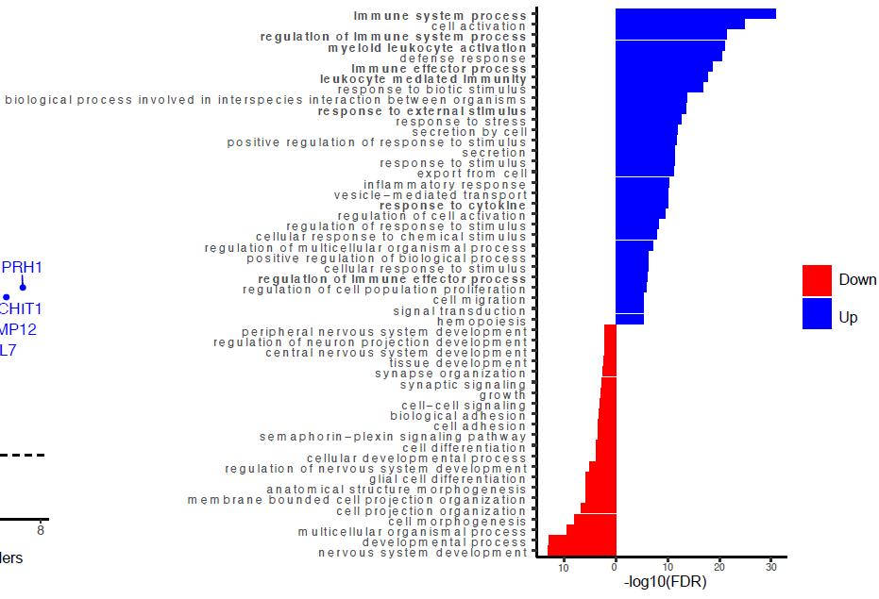
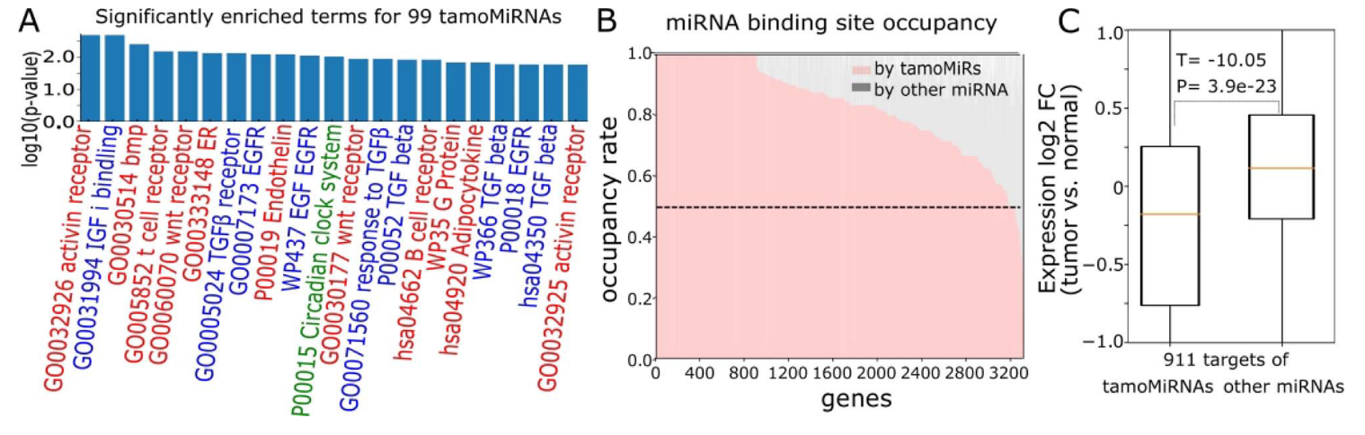
Other considerations in using barcharts
Balance with other subfigures
Bars of different directions (sort by sign, too)
Kim et al. BIB 2020

Slide 20
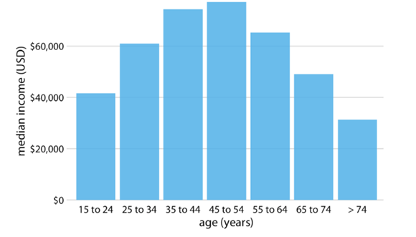
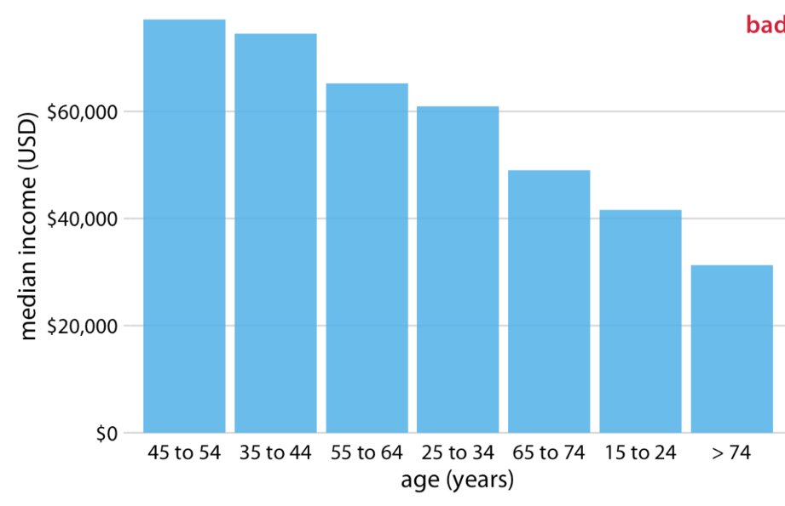
Sorting can be more efficient (not always)
2016 median US annual household income
?
Fundamentals of Data Visualization, Wilke, O’Reilly, 1st Ed.
Notes:
“We should only rearrange bars, however, when there is no natural ordering to the categories the bars represent. Whenever there is a natural ordering (i.e., when our categorical variable is an ordered factor) we should retain that ordering in the visualization. For example, Figure 6.5 shows the median annual income in the U.S. by age groups. In this case, the bars should be arranged in order of increasing age. Sorting by bar height while shuffling the age groups makes no sense (Figure 6.6).”

Slide 21
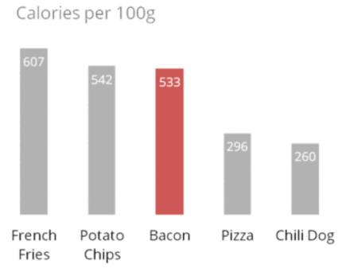
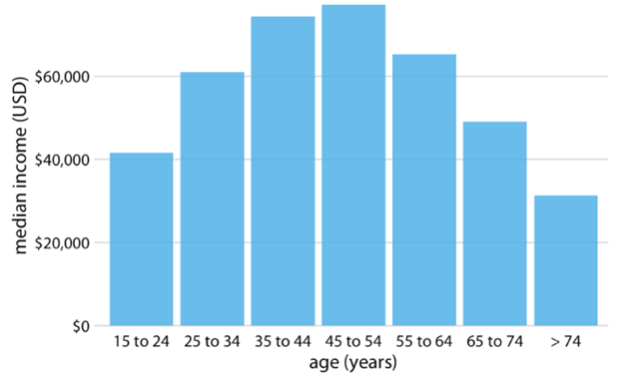
Barplot can visualize precise values
$71,870
$72,124
$62,119
$60,131
$49,561
$40,240
$30,081
Adapted from Fundamentals of Data Visualization, Wilke, O’Reilly, 1st Ed.
Barcharts can show exact values
When to do this would be very context-specific
Notes:
We should only rearrange bars, however, when there is no natural ordering to the categories the bars represent. Whenever there is a natural ordering (i.e., when our categorical variable is an ordered factor) we should retain that ordering in the visualization. For example, Figure 6.5 shows the median annual income in the U.S. by age groups. In this case, the bars should be arranged in order of increasing age. Sorting by bar height while shuffling the age groups makes no sense (Figure 6.6).

Slide 22
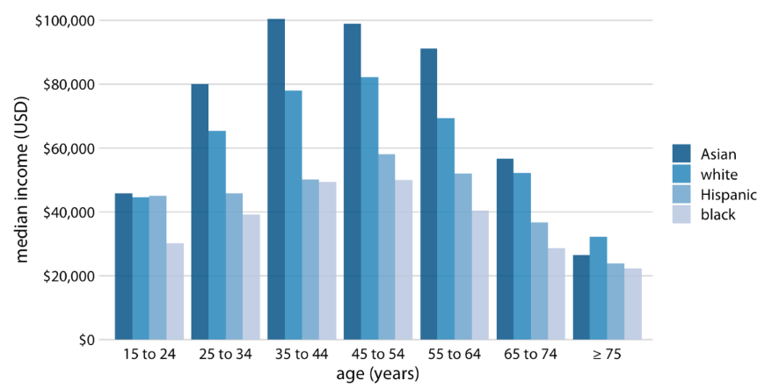
Grouped barplots show values in multiple categories
U.S. Census Bureau report
A group of bars along the x-axis by one variable and then bars within each group by another variable
Comparison among races is emphasized (not among age)
Interested in certain age groups, too
Fundamentals of Data Visualization, Wilke, O’Reilly, 1st Ed.
Notes:
All examples from the previous subsection showed how a quantitative amount varied with respect to one categorical variable. Frequently, however, we are interested in two categorical variables at the same time. For example, the U.S. Census Bureau provides median income levels broken down by both age and race. We can visualize this dataset with a grouped bar plot (Figure 6.7). In a grouped bar plot, we draw a group of bars at each position along the x axis, determined by one categorical variable, and then we draw bars within each group according to the other categorical variable.

Slide 23
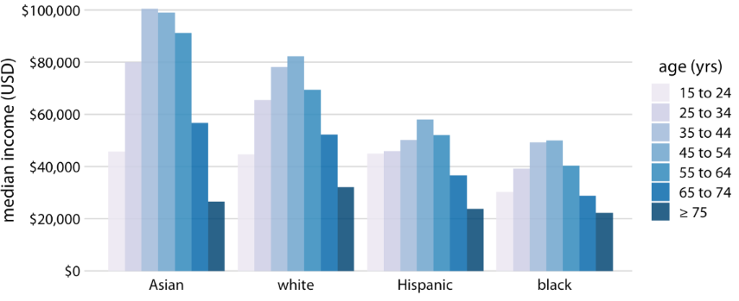
Grouped barplot visualize amount in multiple variables
Comparison among ages is emphasized
If equally interesting, this may be better because
Sequential palette easier to read (for > 2 groups)
Comfortable seeing normal-like distribution (or other shapes that directly show statistical properties)
U.S. Census Bureau report
Fundamentals of Data Visualization, Wilke, O’Reilly, 1st Ed.
Notes:
Grouped bar plots show a lot of information at once and they can be confusing. In fact, even though I have not labeled Figure 6.7 as bad or ugly, I find it difficult to read. In particular, it is difficult to compare median incomes across age groups for a given racial group. So this figure is only appropriate if we are primarily interested in the differences in income levels among racial groups, separately for specific age groups.

Slide 24
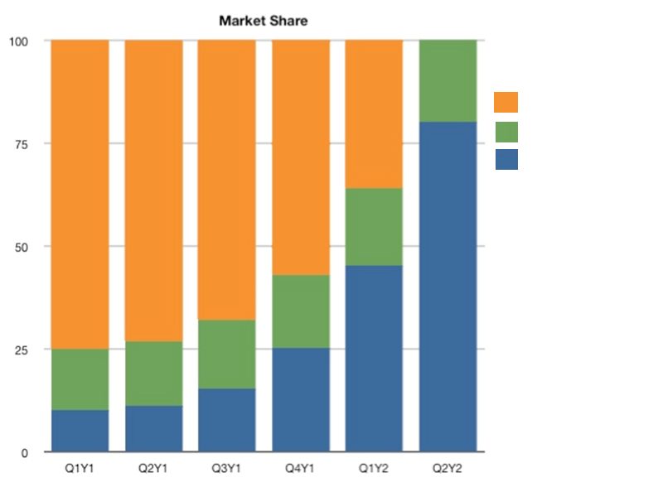
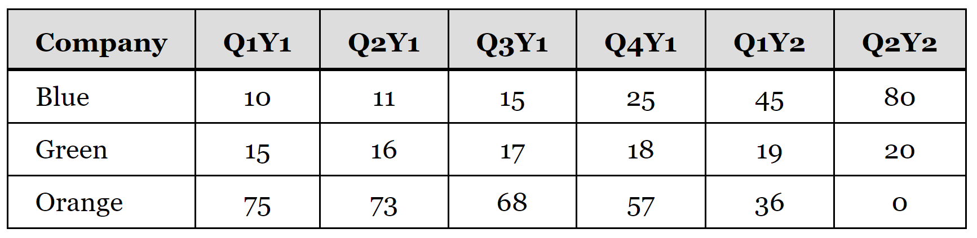
Stacked barplots visualize amount in multiple variables
Timeline of the change in market share
Company
A
B
C
Market share (%)
Pros: preferable when
The total amount is fixed (as is always the case when % is presented)
The trend is somewhat clear
Cons: not clear how each bar actually occupies!
http://www.leancrew.com/all-this/2011/11/i-hate-stacked-area-charts/
Notes:
Instead of drawing groups of bars side-by-side, it is sometimes preferable to stack bars on top of each other. It’s a timeline of the change in market share, in percent, of three companies that are the only manufacturers of a particular device. We’ll call the companies Orange, Green, and Blue and use those colors in our charts. It shows that in Y1 Q1, the orange company dominated, but as time goes, the blue company increases its influence and takes more than 75% of the market share at Y2 Q2. During the times, it seems the green company does not change it share much.

Slide 25
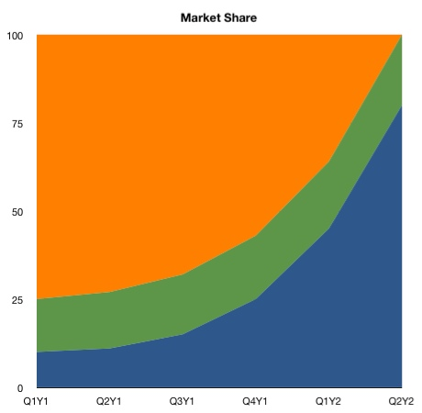
Stacked area chart can distort the trend
General trend preserved
Different from bars put together
Question: How did Green do over this period?
http://www.leancrew.com/all-this/2011/11/i-hate-stacked-area-charts/
Notes:
You may want to go fancier and make stacked area chart instead of stacked bar chart.
At a glance, you may think it is simply bars put together.
However, reading this figure is actually much more confusing than stacked bar chart.
Of course, you can see that orange started out dominating the market, but Blue expanded rapidly and took over.
But here’s the harder question: How did Green do over this period?
To the unwary, it looks like Green lost a bit of market share. Not nearly as much as Orange, of course, but the green swath certainly gets thinner as we move to the right end of the chart.

Slide 26
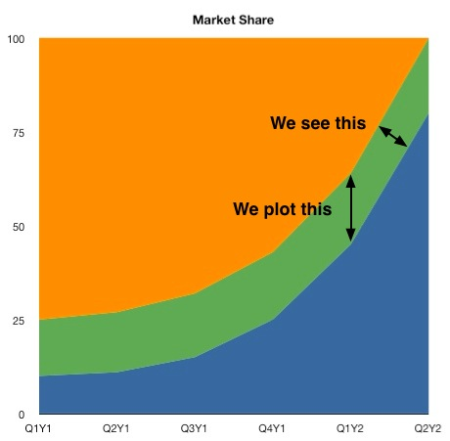
Stacked area chart can distort the trend
Market share shown vertically
But we may perceive thickness of a stream at right angles to that
The overall trend we perceive is determined by “major players”
http://www.leancrew.com/all-this/2011/11/i-hate-stacked-area-charts/
Notes:
the thickness of a stream at right angles

Slide 27
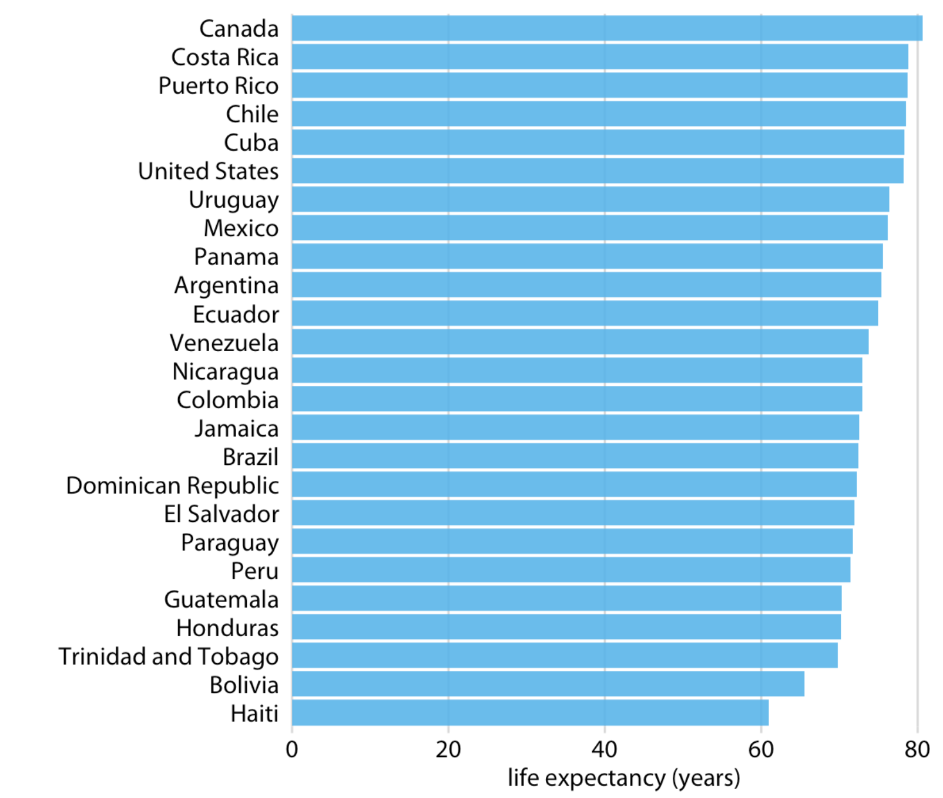
Barplots are assumed to start at zero
25 countries in the Americas
Because bars are taken as physical objects
Pros: the bar length ∝ the amount shown
Cons: maybe impractical or obscure some features, e.g. Uruguay, Mexico, Panama, and Argentina
Fundamentals of Data Visualization, Wilke, O’Reilly, 1st Ed.
Notes:
Bars are not the only option for visualizing amounts. One important limitation of bars is that they need to start at zero, so that the bar length is proportional to the amount shown. Why is it? I believe that it’s because bars represent physical objects. If you draw barplots starting at some positive values not 0, you are technically hanging bars in the air.
For some datasets, this condition can be impractical or may obscure key features.
Figure 6.11 demonstrates this visualization approach for a dataset of life expectancies in 25 countries in the Americas. The citizens of these countries have life expectancies between 60 and 81 years, and each individual life expectancy value is shown with bars.
Then, the problem is

Slide 28
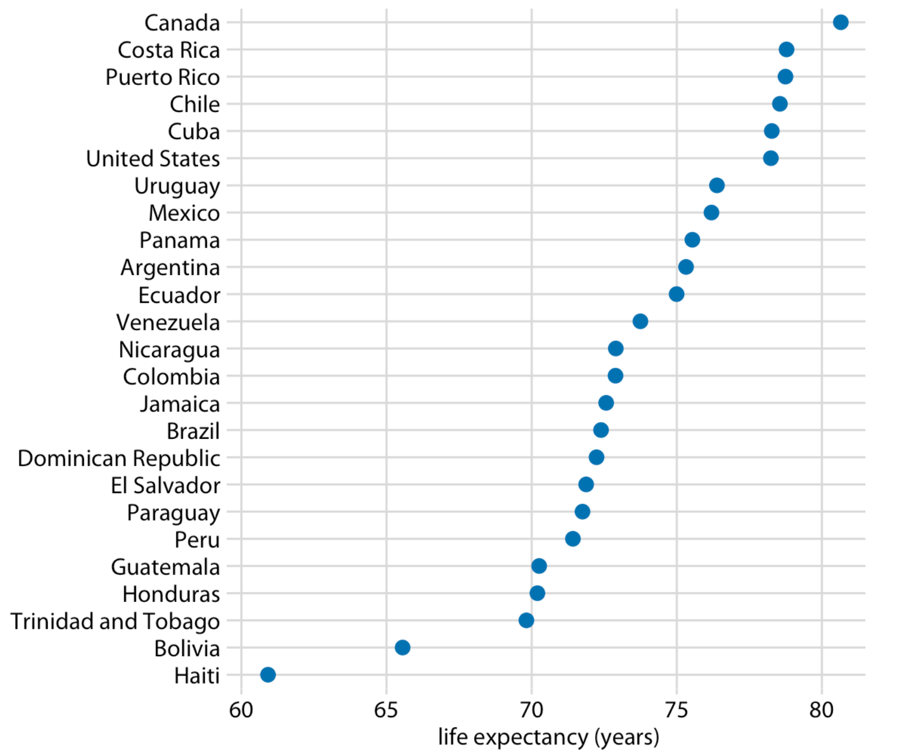
Barplots are assumed to start at zero
25 countries in the Americas
25 countries in the Americas
Fundamentals of Data Visualization, Wilke, O’Reilly, 1st Ed.
Notes:
To make it better… let’s first switch axis to improve reading of the countries.
A more fundamental improvement would be to limit the axis range.
By limiting the axis range to the interval from 60 to 81 years, the figure highlights the key features of this dataset:
If we had used bars instead of dots (Figure 6.12), we’d have made a much less compelling figure. Because the bars are so long in this figure, and they all have nearly the same length, the eye is drawn to the middle of the bars rather than to their end points, and the figure fails to convey its message.

Slide 29
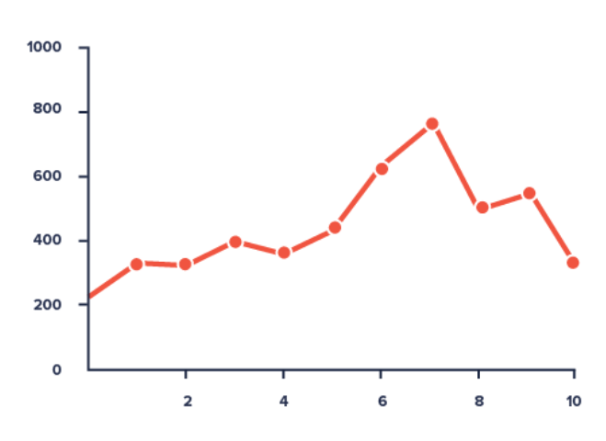
Line graphs show trends for amounts
Barplots are for for static values
Line graph = dot plot (actual data) + real line (trend)
To track changes along the x-axis (e. g., time)
Datavizproject.com
Need to choose between barchart and line graph with purpose
Notes:
Line graph is…
One clear pros is that you can visualize the trend.
However, since we have another class discussing line graphs, we will limit ourselves in this class in discussing only the attributes of line graph relevant to amount visualization.
In this graph, the variable represented in the y-axis is generally increasing with several plateaus and a down-hill after 7.

Slide 30
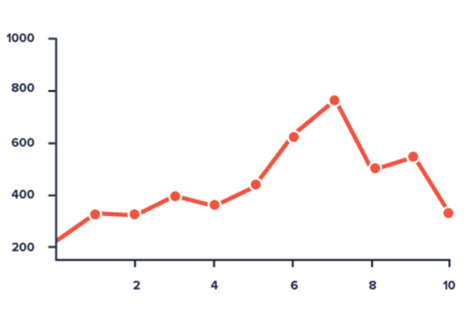
Include a zero baseline if possible
A linegraph does not strictly have to
But better if it does (e.g., compare y-values for x=3 and x=7 in the two plots)
Adapted from Datavizproject.com
Notes:
Although a line chart does not have to start at a zero baseline, it should be included if possible.

Slide 31
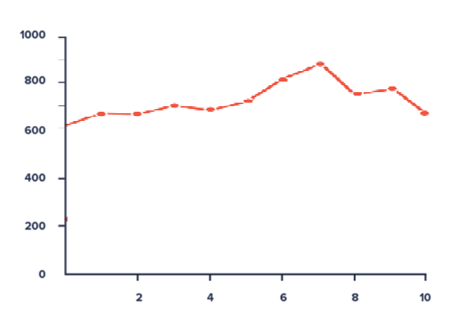
If not possible, truncate the axis
It is not possible when, e.g.,
All data uniformly far from 0
Small fluctuations matter
1000
800
600
Adapted from Datavizproject.com
Notes:
If relatively small fluctuations in data are meaningful (e.g., stock market data), you may truncate the scale to showcase these variations.

Slide 32
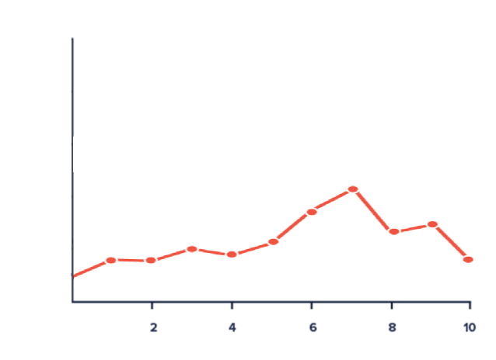
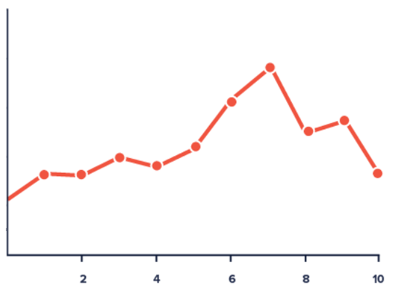
Use the right y-axis limit
Ideally, the linegraph takes up 2/3 of the y-axis’s total scale
If not, you can modify the scale
800
1600
600
1200
400
800
200
400
0
0
Adapted from Datavizproject.com
Notes:
Plot all data points so that the line chart takes up approximately two-thirds of the y-axis’ total scale.

Slide 33


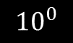

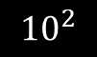


Use the right height
If not, you may want to modify the y-axis scale
e.g., use a logarithm (base 10 here)
$${10}^{8}$$
$${10}^{6}$$
$$population number$$
$${10}^{4}$$
$$population number$$
$${10}^{2}$$
$${10}^{0}$$
0
$$Texas counties, from most to least populous$$
50
100
150
200
250
$$Texas counties, from most to least populous$$
Notes:
Plot all data points so that the line chart takes up approximately two-thirds of the y-axis’ total scale.

Slide 34
Bubble charts to visualize 3 dimensions
Investments to 5 equities
Given three dimensions of data to visualize, how to visualize on a 2D plot?
Put three column charts side by side? Why not?
Use two dot plots? Why not?
 | Age of investment (Year) | Return on investment | The amount of investment (1B$)
A | 1.5 | 22 | 2
B | 4.5 | 75 | 1
C | 6 | 100 | 4
D | 7 | 70 | 3
E | 8 | 21 | 2
Notes:
But both of them will be ineffective in putting together all the 3 parameters in one elegant visualization. Time to say hello to the bubble chart.

Slide 35
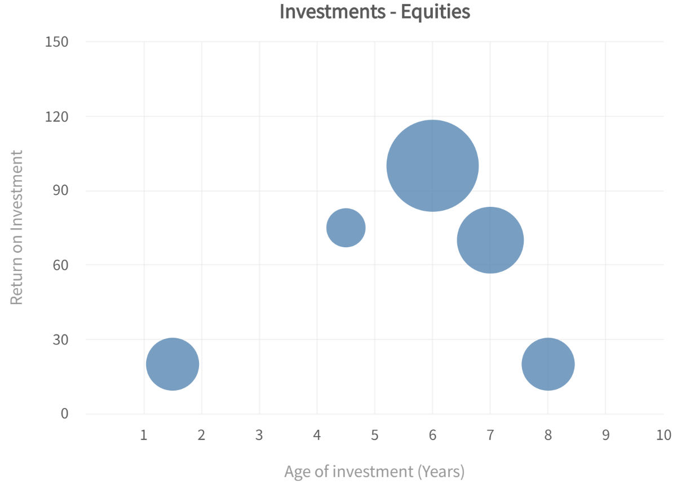
Bubble charts to visualize amounts in 3 dimensions
 | Age of investment (Year) | Return on investment | The amount of investment (1B$)
A | 1.5 | 22 | 2
B | 4.5 | 75 | 1
C | 6 | 100 | 4
D | 7 | 70 | 3
E | 8 | 21 | 2
https://www.fusioncharts.com/resources/chart-primers/bubble-chart
Notes:
Once we are out of the limitation of starting at zero and able to encode information in the circles, it easily turns into another type of figure called bubble chart.
When you have a table with 3 related dimensions of data, how do you represent it on a flat 2D chart? Put three column charts side by side, one for each dimension? Or use two XY-plot charts? But both of them will be ineffective in putting together all the 3 parameters in one elegant visualization. Time to say hello to the bubble chart.
What are bubble charts?
Bubble charts/Bubble graphs plot data defined in terms of three distinct numeric parameters. They allow the comparison of entities in terms of their relative positions with respect to each numeric axis and their size as well.
Column charts and line charts have 2 axes commonly – a numeric axis and a categorical axis. The Y-Axis is the numeric axis for column and line charts. This means that the quantitative magnitude of the plot is indicated by the position of the plot with respect to the Y-axis. Bubble charts are different because both axes of a bubble chart are numeric. Hence, the position of the bubble plot is an indicator of two numeric values.
The area of the bubble plot (or the scatter blot bubble size) is an indicator of the magnitude of the third numeric characteristic.
(This is a scatterplot, with point size determined by a third variable.)

Slide 36
Bubble charts to visualize amounts in 3 dimensions
Bubblechart
To compare and depict the variable relationship by the position (1st and 2nd) and the size (3rd)
https://www.fusioncharts.com/resources/chart-primers/bubble-chart
Notes:
The bubble chart is used to visualize data that is defined by three numeric variables.Two variables locate the point on the x- and y-axis and the third variable is indicated by the diameter of the bubble. Typically, this chart is used to compare and depict relationships between variables by means of positioning and proportions of the size of the bubbles/circles. It is also used to analyze patterns and trends in data.

Slide 37
Bubble charts to visualize amounts in 3 dimensions
Bubblechart
To compare and depict variable relationships by the position (1st and 2nd) and the size (3rd)
Also to analyze, e.g.,
Best investments
Good investments
Not-so good investments
Decent investments
https://www.fusioncharts.com/resources/chart-primers/bubble-chart
Notes:
The same bubble chart has been divided into 4 quadrants. Depending on the parameters, each of the quadrants has a particular meaning for you.
Quadrant 1 - Best investments: Investments that have given high RoI in a short period of time. What else could you ask for? These investments are like jackpots.
Quadrant 2 - Good investments: Long Age of Investment but great RoI. If you are planning to make further investments, you would surely invest in the equities in this quadrant.
Quadrant 3 - Not-so good investments: Low RoI over a long period of time. Further investment on equities in this quadrant would be your last bet.
Quadrant 4 - Decent investments: Manageable RoI over a short span of time. If you are thinking short-term investment, then this is your quadrant.
With a larger number of data plots, mental divisions like this are very helpful in determining the next course of action.

Slide 38
Bubble charts to visualize amounts in 3 dimensions
Bubblechart
To compare and depict variable relationships by the position (1st and 2nd) and the size (3rd)
Also to analyze, e.g.
Best investments
Good investments
Not-so good investments
Decent investments
The 3rd dimension also can be in bubble color
Amount of
investment (1B$)
1
2
3
4
Return on Investment
Age of investment (Years)
https://www.fusioncharts.com/resources/chart-primers/bubble-chart
Notes:
The same bubble chart has been divided into 4 quadrants. Depending on the parameters, each of the quadrants has a particular meaning for you.
Quadrant 1 - Best investments: Investments that have given high RoI in a short period of time. What else could you ask for? These investments are like jackpots.
Quadrant 2 - Good investments: Long Age of Investment but great RoI. If you are planning to make further investments, you would surely invest in the equities in this quadrant.
Quadrant 3 - Not-so good investments: Low RoI over a long period of time. Further investment on equities in this quadrant would be your last bet.
Quadrant 4 - Decent investments: Manageable RoI over a short span of time. If you are thinking short-term investment, then this is your quadrant.
With a larger number of data plots, mental divisions like this are very helpful in determining the next course of action.

Slide 39
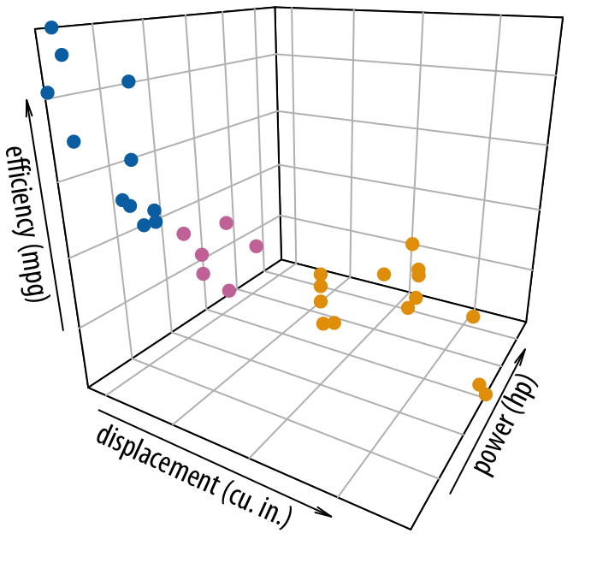
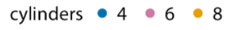
Bubbles chart avoid representation in 3D
Difficult to envision where the points are in space
Data transformation from the data space into the 3D
Data transformation from the 3D to 2D problematic, since
non-invertible (a point in 2D a line in 3D)
Our attempt unreliable
Fuel efficiency vs. displacement and power for 32 cars
Fundamentals of Data Visualization, Wilke, O’Reilly, 1st Ed.
Notes:
unreliable, fraught with error, and highly dependent on appropriate cues in the image that convey some sense of three-dimensionality.

Slide 40
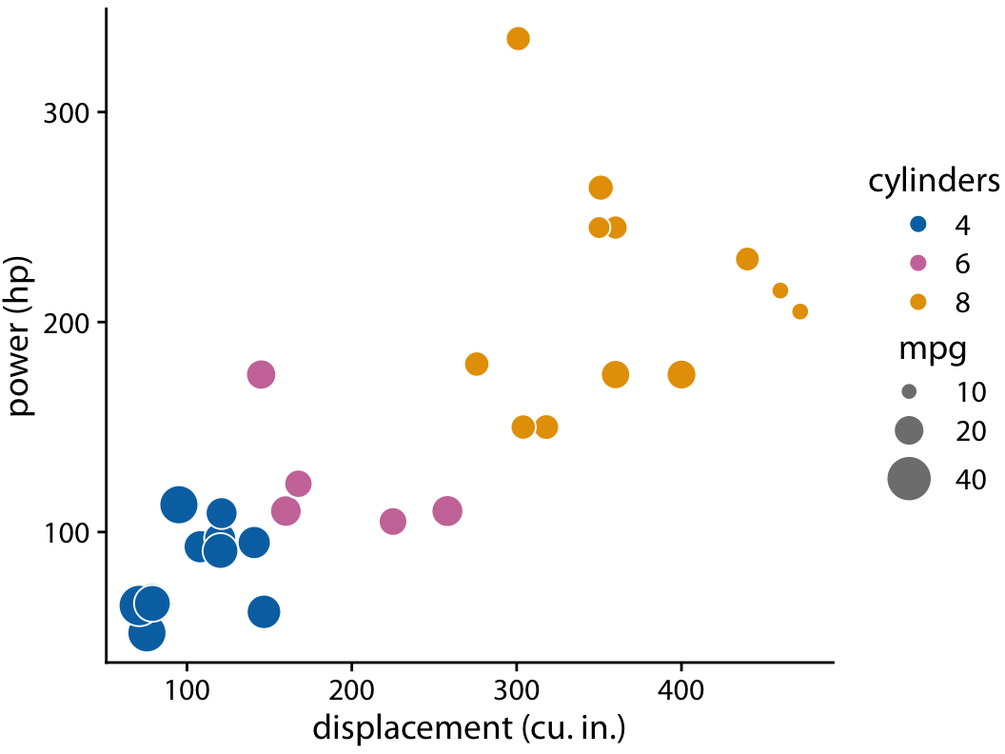
Bubble chart can represent 3D
Fuel efficiency vs. displacement and power for 32 cars.
For overlaps, you can
Control transparency levels
Give jittering
Fundamentals of Data Visualization, Wilke, O’Reilly, 1st Ed.
Notes:
Instead of applying two separate data transformations, one of which is non-invertible, I think it is generally better to just apply one appropriate, invertible transformation and map the data directly into 2D space. It is rarely necessary to add a third dimension as a position scale, since variables can also be mapped onto color, size, or shape scales. we can plot power versus displacement and map fuel efficiency onto the size of the dots

Slide 41
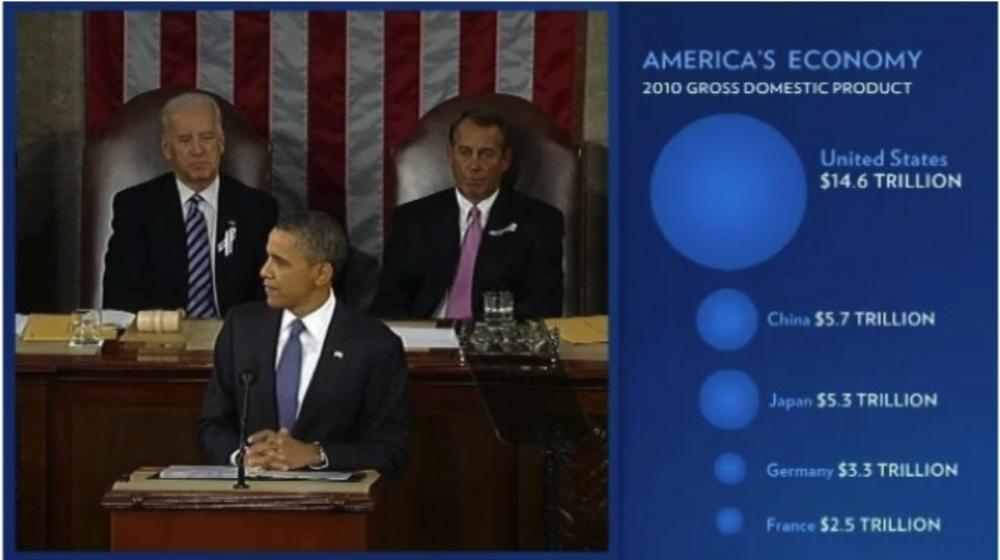
Bubble size scaled in area
In the example, the radius of circle scaled with the size of economy
The radius scales linearly, but the area scales quadratically
The 2011 State of the Union Address
Notes:
Here is an example coming from the Barack Obama’s State of the Union speech in 2011. It shows the 2010 Gross Domestic Product of 5 countries, each value being represented by a circle. The radius of each circle has been scaled based on the size of each nation’s economy.
Here, America’s economy looks way bigger than the others.
This distorts the perception of the relative sizes of the circles since the radius scales linearly, but the area scales quadratically. Basically, the size of the United States economy appears much bigger than it should.

Slide 42
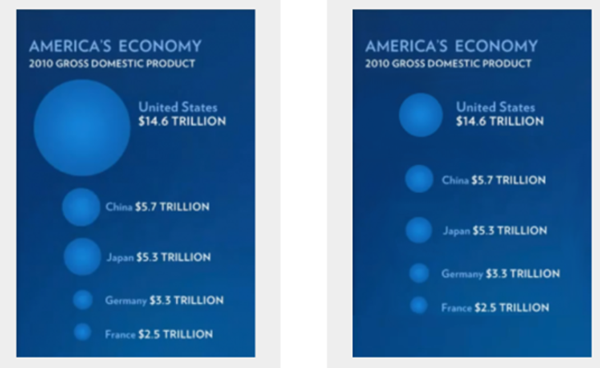
Bubble size should be in area
Before and after correction
https://blog.fastfedora.com/2011/01/2011-state-of-the-union-visualizations.html

Slide 43
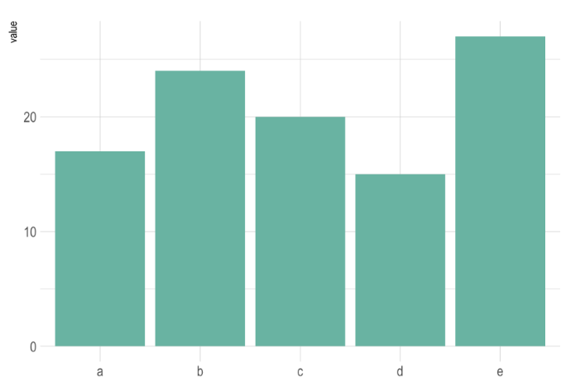

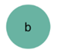
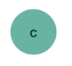
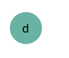
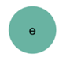
Bubble sizes difficult to compare
e.g. Data points of size 17, 24, 20, 15, 27
In buble area size
In barplot
Used with a scaling factor
Attention usually goes to the biggest and the smallest

Slide 44
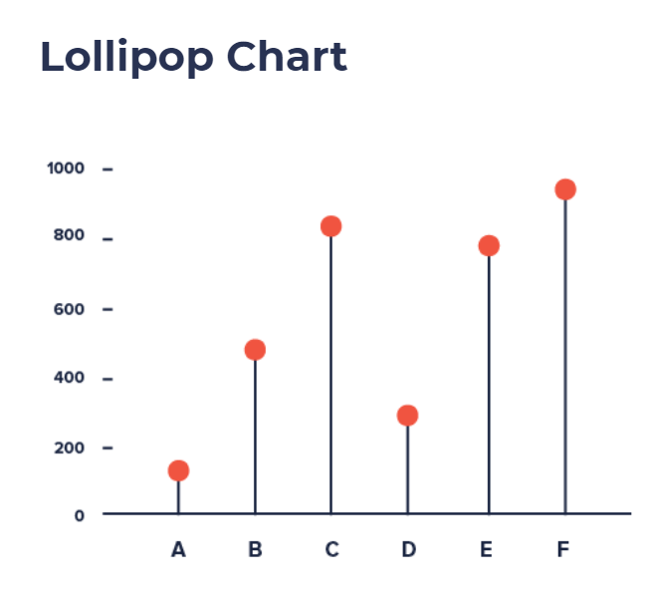
Lollipop to start at 0 while highlighting endpoints
Lollipop (=a line and a dot) combines the advantages of
Box: direct representation easily perceived
Dot: flexible for radical changes in a wider range
e.g. a large set of tall columns not intimidating
but with inherent inaccuracies due to
The location of the center
Half of the circle extending
Datavizproject.com
Notes:
The center of the circle at the end of the lollipop marks the value, but the location of the center is difficult to judge, making it imprecise compared to the straight edge of a bar, and half of the circle extends beyond the value that it represents, making it inaccurate.
Related chart types includes the dumbbell plot which focus on the span between two values, by highlighting the difference.

Slide 45
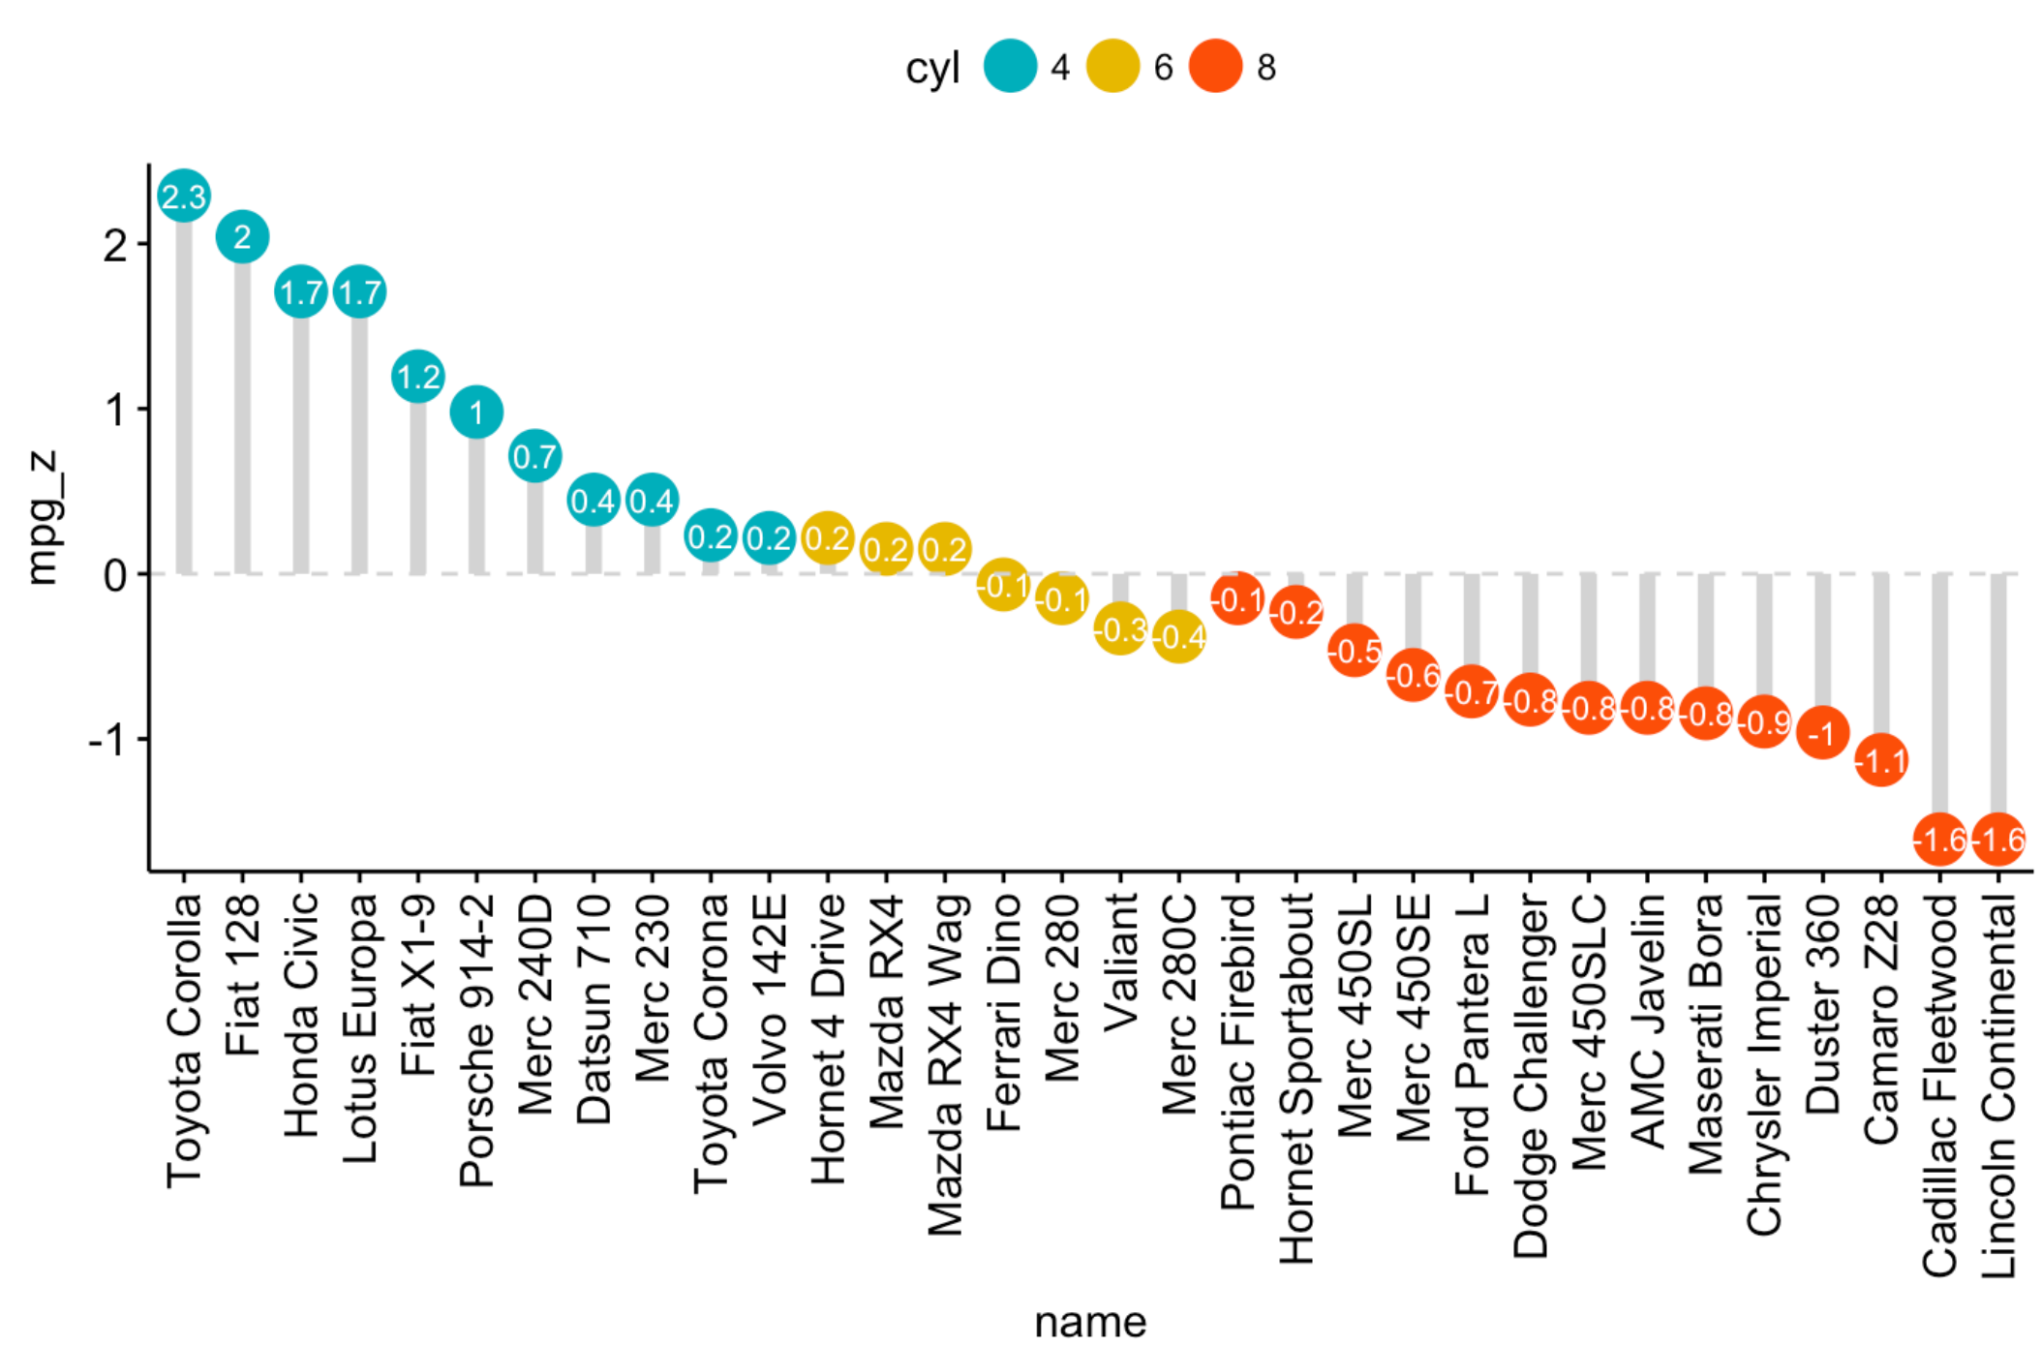
Lollipop to start at 0 while highlighting endpoints
Lollipop (a line and a dot) without the inherent inaccuracies due to
Circle center imprecision
Important to sort
Adapted from http://www.sthda.com/english/articles/24-ggpubr-publication-ready-plots
Notes:
To make up for the limitation, for example, people usually write the value in the circle.
This figure shows mpg value for each car sorted by mpg and grouped by cylinder.
Without the numbers at the center of the circles, you might not be able to tell their exact mpg.
As you can see, it is important to sort to be able to read the figure efficiently.
Notice that the partial shorting may give the erroneous impression of a consistent downward trend.

Slide 46
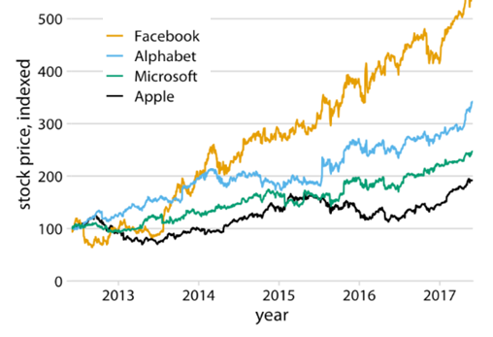
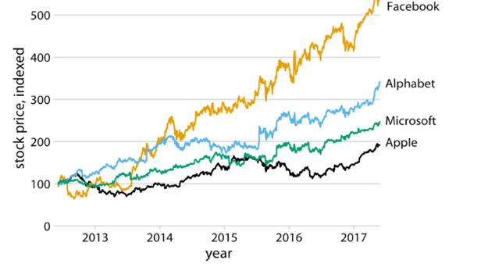
Label lines directly
To avoid
Referencing a legend (legend locations can vary)
Obstructing signals
Adapted from Fundamentals of Data Visualization, Wilke, O’Reilly, 1st Ed.
Notes:
This lets readers quickly identify lines and corresponding labels instead of referencing a legend.
If you do use a legend, try to put the plotting elements in a sensible order.

Slide 47
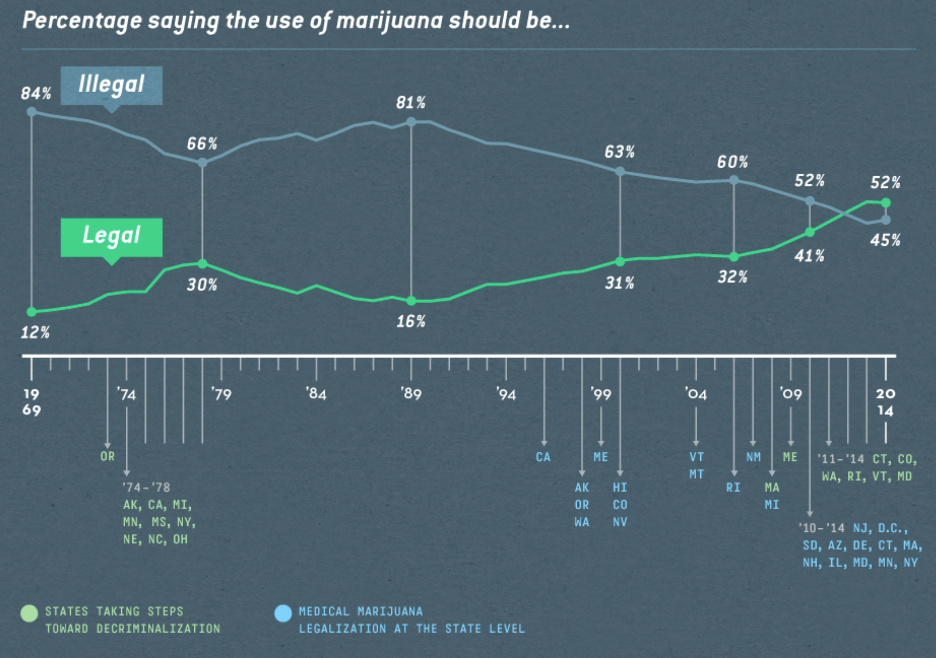
Distinguish points from lines in line graphs
Stylish lines can obstruct data points.
Which are real values?
Are all the datapoints indicated with dots?
Which values on the lines are just interpolations?
http://wp_media-prod.s3.amazonaws.com/app/uploads/2015/09/24113017/Infographic_Design_Example_Digit.png
Notes:
What’s worse in this figure and many others is that they removed some data points so that it is difficult to know where else on the line we have data points.
(Also the colors of the lines seems to be confusingly unrelated to the way the same-ish colors are used below in the timeline to represent decriminalization/legalization events.)

Slide 48
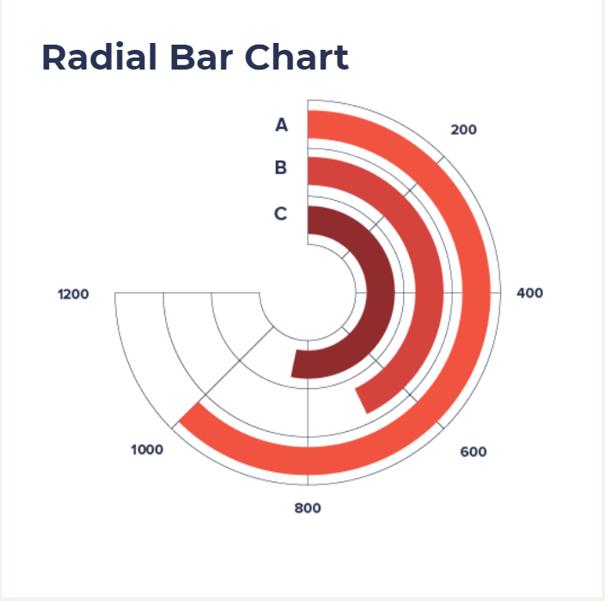
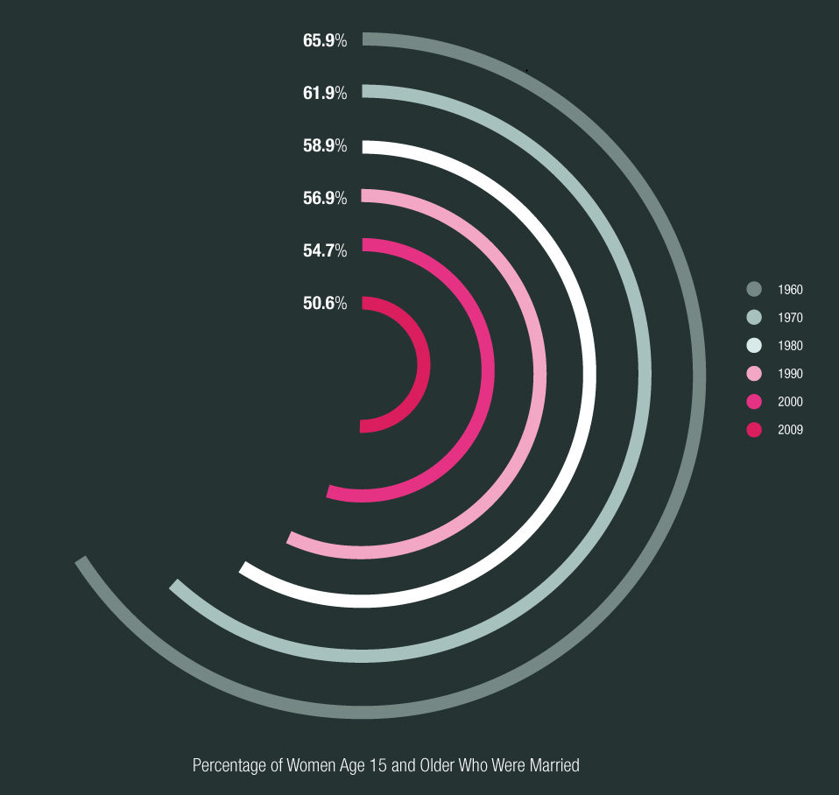
Radial Barchart
Barchart on radial axis
Pros: ?
Cons: deceptive, probably more difficult to read
Datavizproject.com
https://www.pinterest.dk/pin/504473595739909173/

Slide 49
Radial barchart limitations
The bars are on arcs of different radii!
So their lengths can’t be compared directly! Rescaling needed.
https://www.data-to-viz.com/caveat/circular_barplot_accordeon.html

